Slide 1
Using Bayesian Optimization in Pose Graphs Based SLAM 9th June
Zuxun Wang

Slide 2
Progress Since Last Meeting
Reviewed CW2-Part 3
System Models
Test proposition 3 and 4
LandmarkVehicleTrackingExample.m
GPSVehicleTrackingExample.m

Slide 3
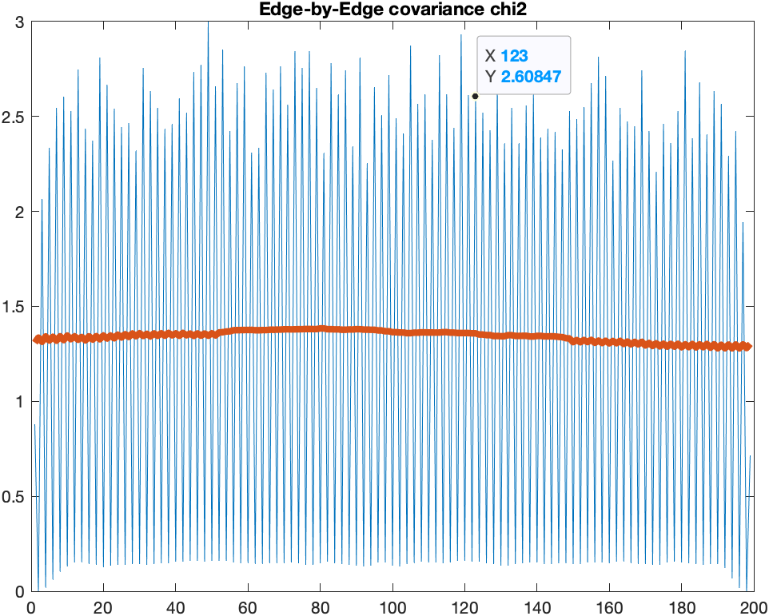
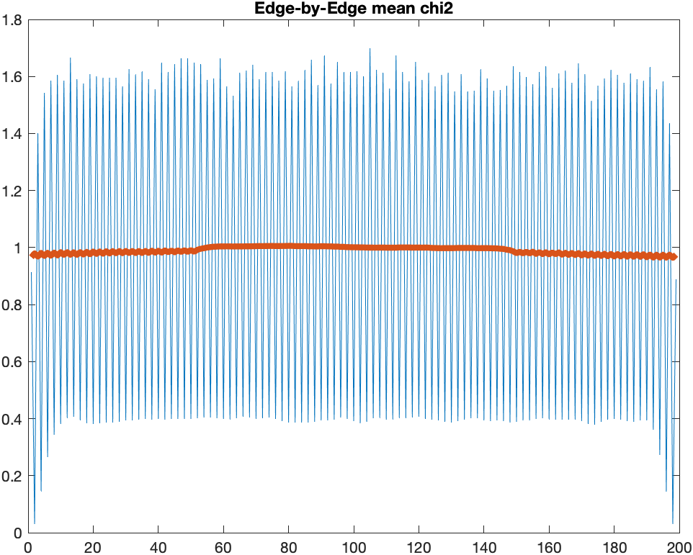
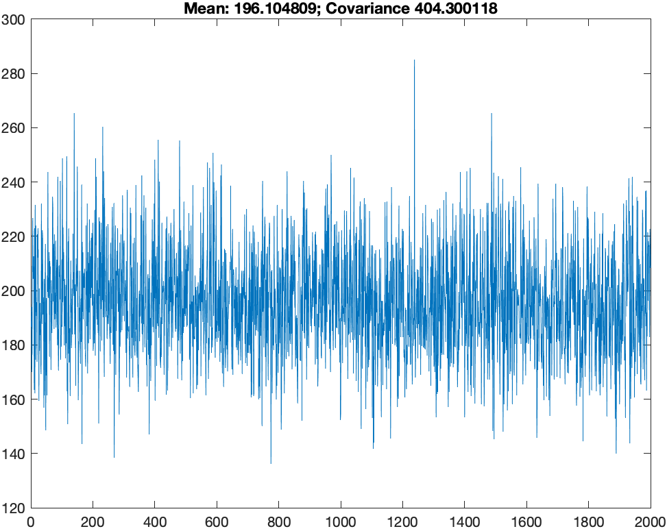
Enable Testing Proposition 4 and set OmegaScale to 1

Slide 4
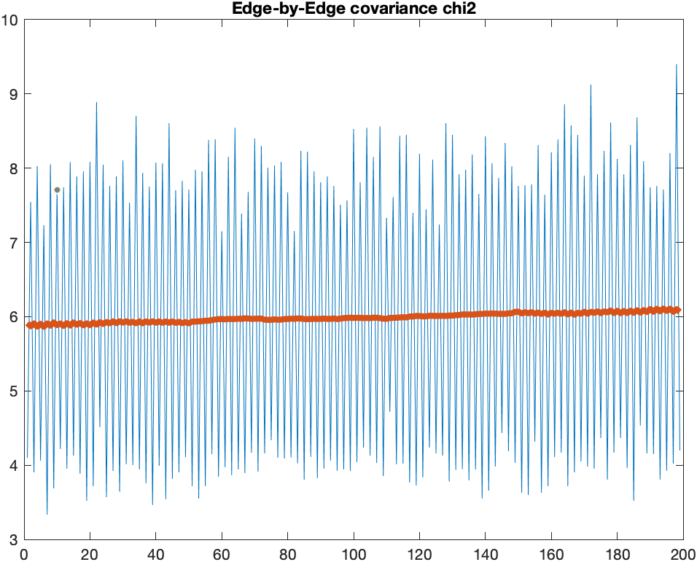
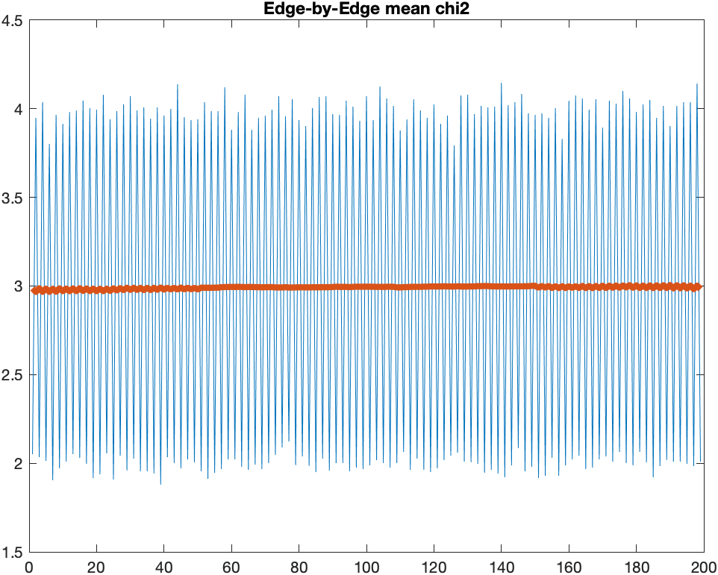
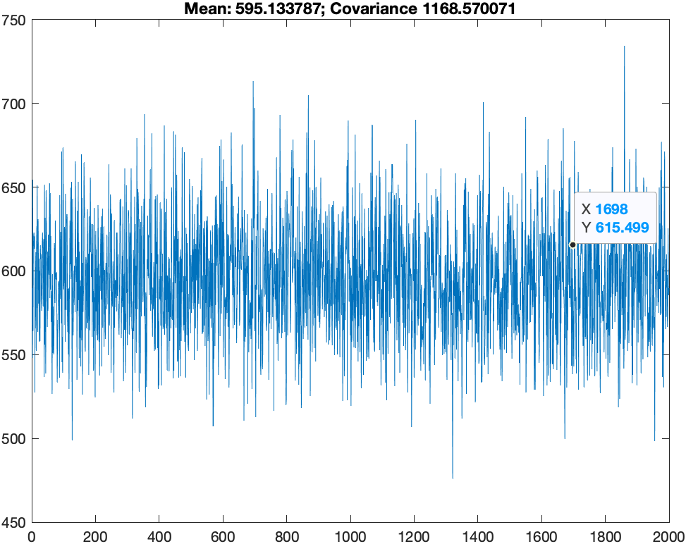
Disable Testing Proposition 4 and set OmegaScale to 1

Slide 5
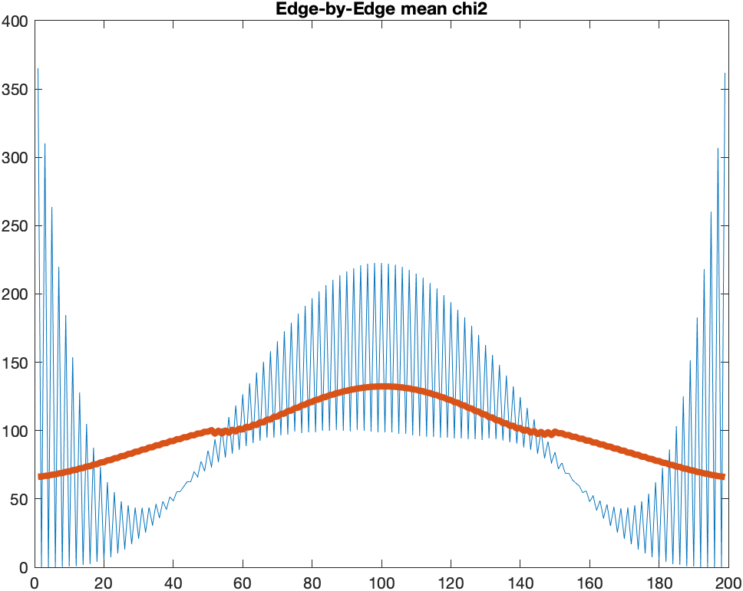
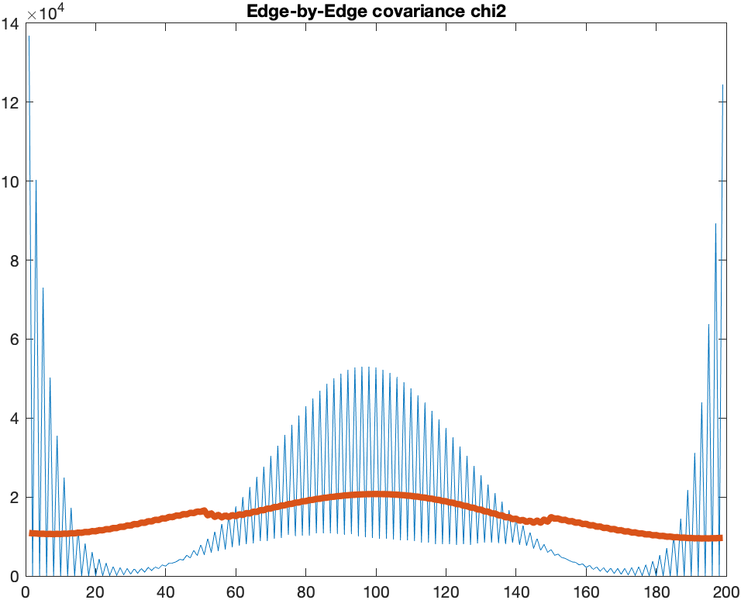
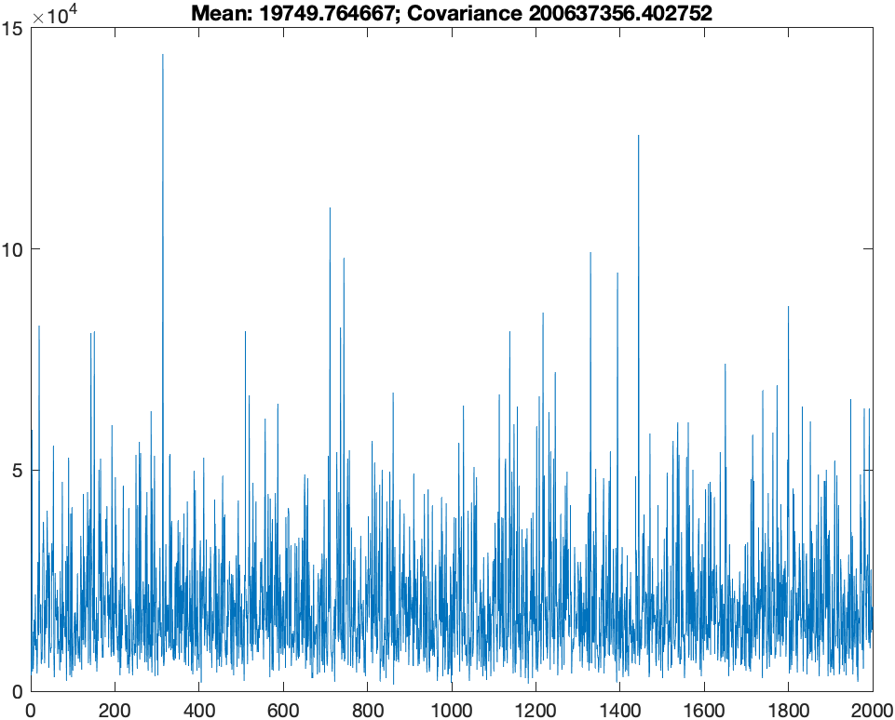
Enable Testing Proposition 4 and set OmegaQScale to 10,000

Slide 6
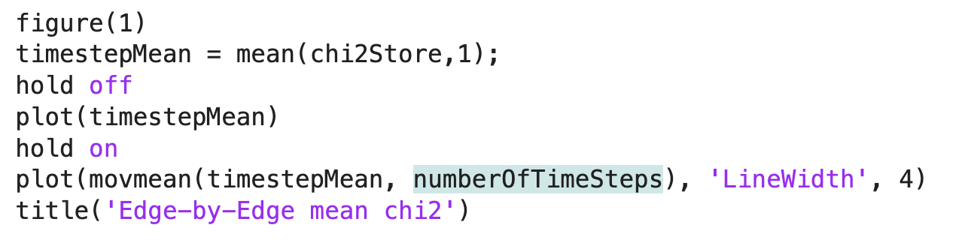

Problems / Issues
When calculating the moving average of timestepMean/timestepCov , why we use the numberOfTimeSteps as the size of sliding window?
(Confusing about this, as mean(chi2Store,1) computes the average chi2 value for each edge in a run, why name it after timestepMean?)

Slide 7
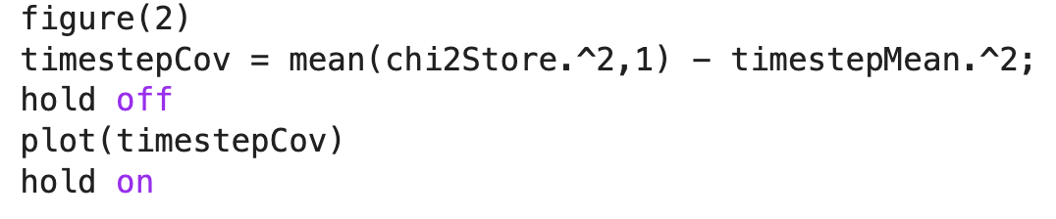
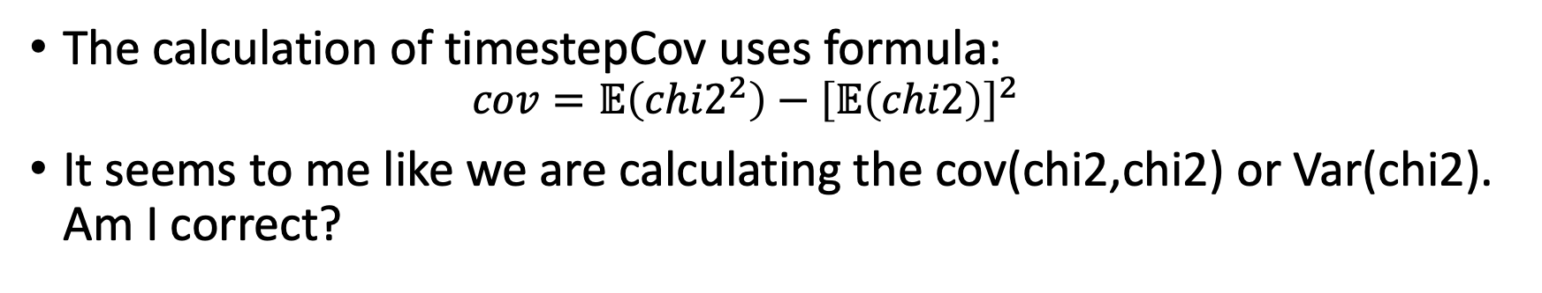
Problems / Issues
The calculation of timestepCov uses formula:
$$cov=𝔼\left(ch{i2}^{2}\right)−{\left[𝔼\left(chi2\right)\right]}^{2}$$
It seems to me like we are calculating the cov(chi2,chi2) or Var(chi2). Am I correct?

Slide 8
Planned Activities
Read the paper, and understand and digest the Fig. 2 and 3.
Linear model
Paper -> CNIS measure to see if graph is tuned correctly.
Try with linear model to do things similar to Fig. 3
Changing the scale to OmegaR and OmegaQ.
Template code
Try to migrate non-linear models to test propositions 3,4
Don’t worry about Bayes Opt (For now)

